Slide 1
Result of GAN for MoG
Junyeob Kim

Slide 2
Notes
Used DCGAN in Tensorflow webpage
5000 sets of 28*28 array for training and validation
Different random seed
500 sets of 28*28 array for test
10 different random seeds
Loss function for Generator and Discriminator – cross entropy
Error function used for testing – mean squared error

Slide 3
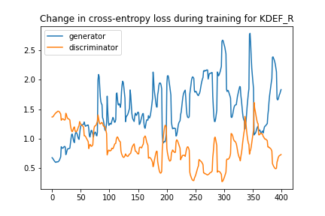
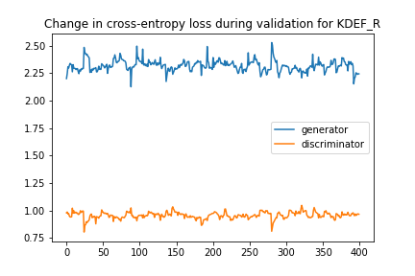
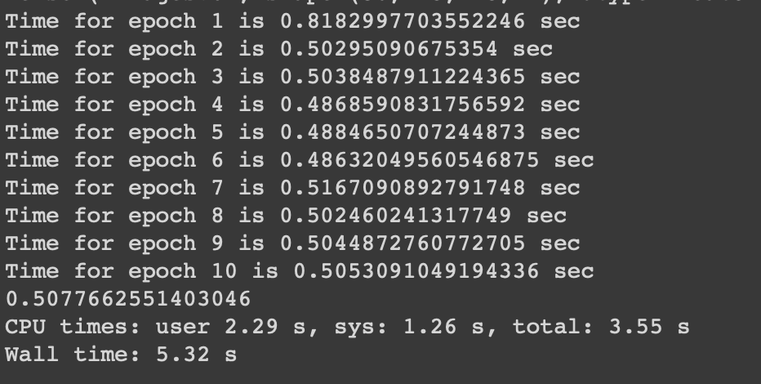
Result for KDEF_R
Resulting error :

Slide 4
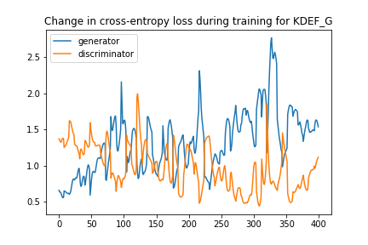
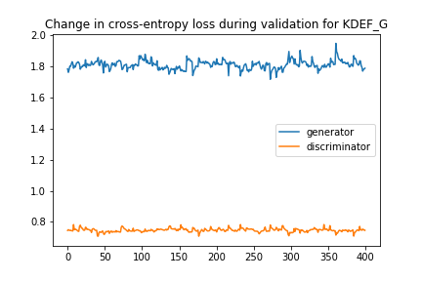
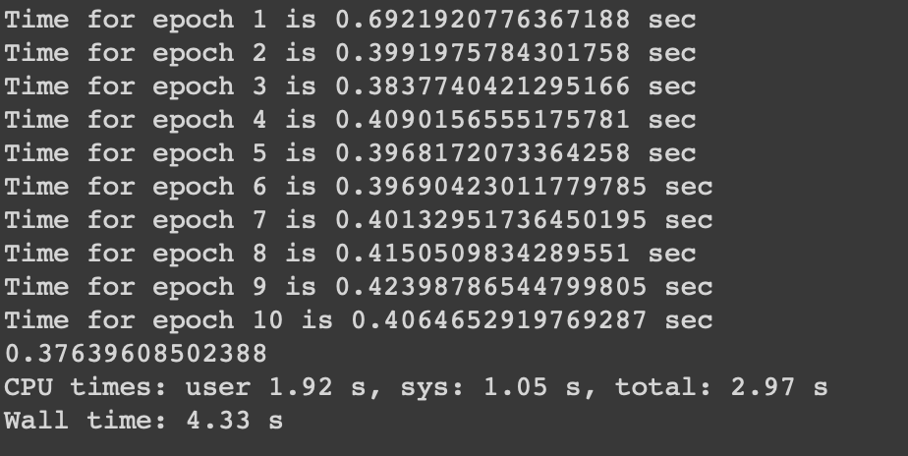
Result for KDEF_G
Resulting error :

Slide 5
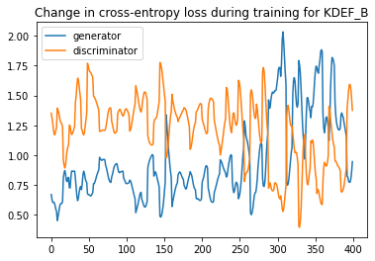
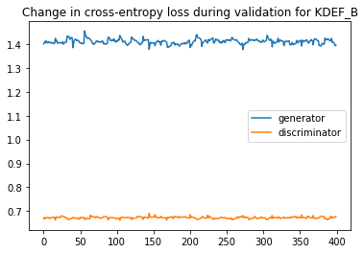
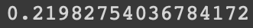
Result for KDEF_B
Resulting error :

Slide 6
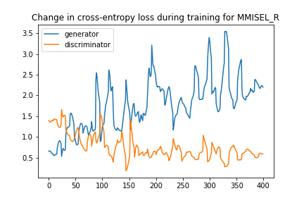
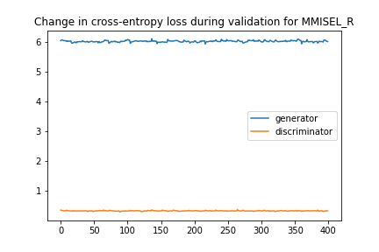
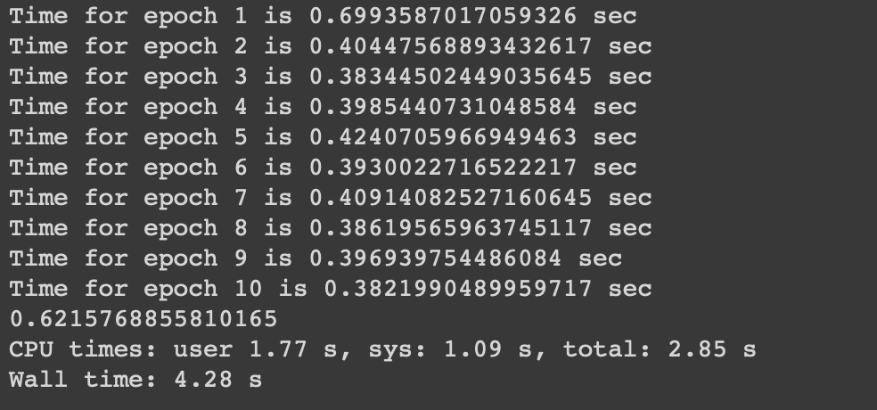
Result for MMISEL_R
Resulting error :

Slide 7
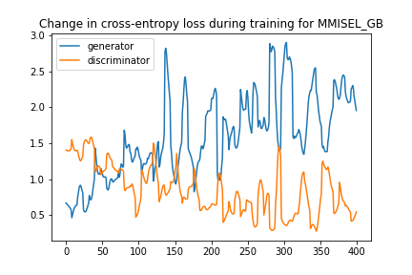
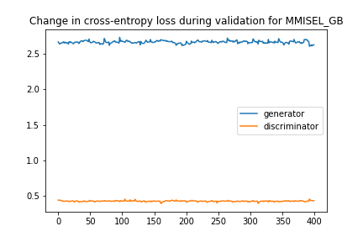
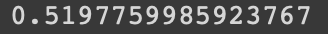
Result for MMISEL_GB
Resulting error :

Slide 8
Conclusion
Resulting training and validation graphs show that there is possibility of overfitting (high Generator loss for validation set)
Model seems to behave differently if the model is re-trained from beginning
All graphs, and resulting error changes significantly
Not enough evidences to prove this
If true, this is due to the model itself, as it uses CNN. Input arrays does not have locational features because it is just made of random numbers that follows the MoG distribution.

